Slide 1

ELECTRONIC COMMUNICATIONS SYSTEMS (DEE 4413) SEMESTER JAN 2021 Slide 1
Lecturer: Dr. Siti Sarah Binti Md. Sallah
Email: sitisarah@lincoln.edu.my
Faculty of Engineering
Lincoln University College (LUC)
Notes:
-perkenalkan diri
-berkenalan dengan student
-representative of class

Slide 2
ASSESSMENT MARKS
Assessment | Percentage
Test | 30
Assignment | 15
Lab Report | 20
Forum/Online discussion | 15
Final Exam | 20

Slide 3
Objectives:
To understand the principles of basic communication systems.
To define information, message and signals.
To explain the elements of communication systems.
The explain the terms modulation and why they are needed in communication system.
To explain the limitations in communication system.
To define frequency and wavelength
To understand the use of decibel (dB) in communication system.

Slide 4

Definition of signal and systems
A signal is any physical phenomenon which conveys information.
System respond to signals and produce new signals.
Excitation signals are applied at system inputs and response signals are produced at system outputs.

Slide 5

A Communication System as a System Example
A communication system has an information signal plus noise signals.
This is an example of a system that consists of an interconnection of smaller systems.

Slide 6
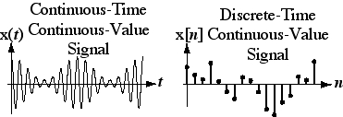
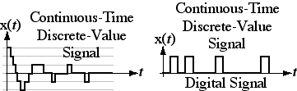
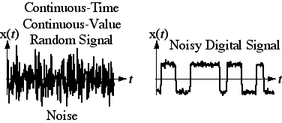
Signal Types

Slide 7
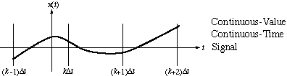
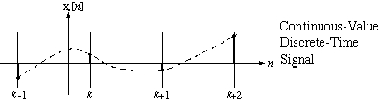
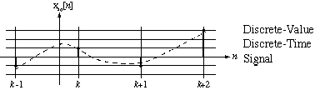
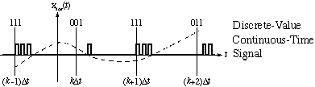
Conversions Between Signal Types
Sampling
Quantizing
Encoding

Slide 8
COMMUNICATION SYSTEMS
Communications:
Transfer of information from one place to another.
Should be efficient, reliable and secured.
Communication system:
Components/subsystems act together to accomplish information transfer/exchange.
Electronic Communication system:
Transmission, reception and processing of information between two or more locations using electronic circuits.
Information Source
Analog/ Digital form
Notes:
the independent variable is what you change, and the dependent variable is what changes because of that
Variable: Pembolehubah
Independent: Bebas (age and time)
Dependent: Bergantung (Height)

Slide 9
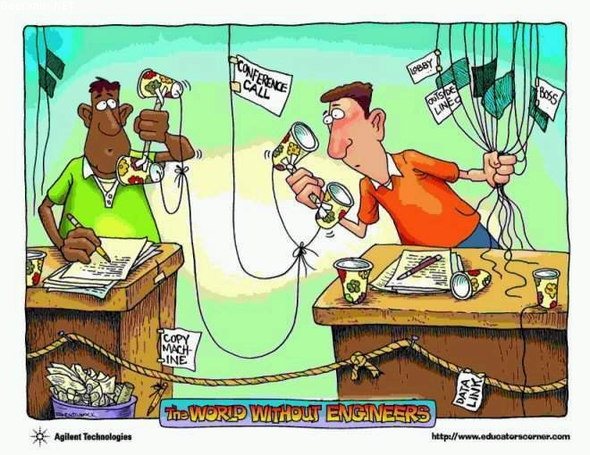
Need for Communication
Importance of Communication:
Exchange of information between two parties separated in distances in a more faster and reliable way.

Slide 10
Information, message and signals
Information
The commodity produced by the source for transfer to some user at the destination.
Message
The physical manifestation of information as produced by the information source.
Signals
A physical embodiment of information – voltage signal or current signal

Slide 11
Brief History in Communication
Year Events
1844 Telegraph
1876 Telephone
1904 AM Radio
1923 Television
1936 FM Radio
1962 Satellite
1966 Optical links using laser and fiber optics
1972 Cellular Telephone
1989 Internet

Slide 12
Analog vs. Digital
Analog
Continuous Variation
Assume the total range of frequencies/ time
All information is transmitted.
Digital
Takes samples:
Non continuous stream of on/off pulses
Translates to 1’s and 0’s

Slide 13
Analog vs. Digital
Digital CS
Advantages:
-Inexpensive
-Privacy preserved(data encrypted)
-Can merge different data
-error correction
Disadvantages:
-Larger bandwidth
-synchronization problem is relatively difficult
Analog Cs
Disadvantages:
-expensive
-No privacy preserved
-Cannot merge different data
-No error correction capability
Advantages:
-smaller bandwidth
-synchronization problem is relatively easier.

Slide 14
Basic Requirements of Communication System
Rate of information transfer:
how fast the information can be transferred
Purity of signal received:
whether the signal received is the same as the signal being transmit
Simplicity of the system
the simpler the system, the better
Reliability

Slide 15
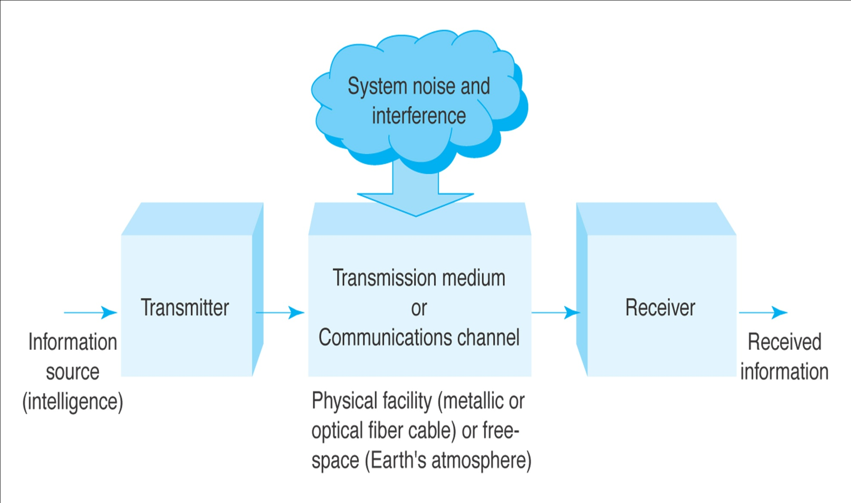
Elements of Communication System(CS)

Slide 16
Elements of CS (cont…)
Information
The communication system exists to convey a message.
Message comes from information source
Information forms - audio, video, text or data

Slide 17
Cont…
Transmitter:
Processes input signal to produce a transmitted signal that suited the characteristic of transmission channel.
E.g. modulation, coding, mixing, translate
Other functions performed - Amplification, filtering, antenna
Message converted to into electrical signals by transducers
E.g. speech waves are converted to voltage variation by a microphone

Slide 18
Elements of CS (cont…)
Channel (transmission media):
a medium that bridges the distance from source to destination. Eg: Atmosphere (free space), coaxial cable, fiber optics, waveguide
signals undergoes degradation from noise , interference and distortion

Slide 19
Elements of CS (cont…)
Receiver:
to recover the message signal contained in the received signal from the output of the channel, and convert it to a form suitable for the output transducer.
E.g. mixing, demodulation, decoding
Other functions performed: Amplification, filtering.
Transducer converts the electrical signal at its input into a form desired by the system used

Slide 20
Modulation
What is modulation?
a process of changing one or more properties of the analog carrier in proportion to the information signal.
One of the characteristics of the carrier signal is changed according to the variations of the modulating signal.
AM – amplitude
FM – frequency
PM - phase

Slide 21
Modulation (cont…)
Why modulation is needed?
To generate a modulated signal suited and compatible to the characteristics of the transmission channel.
For ease radiation and reduction of antenna size
Reduction of noise and interference
Channel assignment
Increase transmission speed

Slide 22
Noise, interference and distortion
Noise
unwanted signals that coincide with the desired signals.
Two type of noise:internal and external noise.
Internal noise
Caused by internal devices/components in the circuits.
External noise
noise that is generated outside the circuit.
E.g. atmospheric noise,solar noise, cosmic noise, man made noise.

Slide 23
Noise, interference and distortion (Cont…)
Interference
Contamination by extraneous signals from human sources.
E.g. from other transmitters, power lines and machineries.
Occurs most often in radio systems whose receiving antennas usually intercept several signals at the same time
One type of noise.

Slide 24
Noise, interference and distortion (Cont…)
Distortion
Signals or waves perturbation caused by imperfect response of the system to the desired signal itself.
May be corrected or reduced with the help of equalizers.

Slide 25
Limitations in communication system
Technological problems
Includes equipment availability, economic factors, federal regulations and interaction with existing systems.
Problem solved in theory but perfect solutions may not be practical.

Slide 26
Limitations in communication system (cont…)
Physicals limitations
Bandwidth limitation
Measure of speed
The system ability to follow signal variations depends on the transmission bandwidth.
Available bandwidth determines the maximum signal speed.

Slide 27
Limitations in communication system (cont…)
Noise limitation
Unavoidable.
The kinetic theory.
Noise relative to an information signal is measured in terms of signal to noise ratio (SNR).

Slide 28
FREQUENCY AND WAVELENGTH
Cycle - One complete occurrence of a repeating wave (periodic signal) such as one positive and one negative alternation of a sine wave.
Frequency - the number of cycles of a signal that occur in one second.
Period - the time distance between two similar points on a periodic wave.
Wavelength - the distance traveled by an electromagnetic (radio) wave during one period.

Slide 29
PERIOD AND FREQUENCY COMPARED
T = One period
time
One cycle
Frequency = f = 1/T

Slide 30
Frequency and wavelength compared
+
T
0
time
f = 1/T
λ
distance

Slide 31
CALCULATING WAVELENGTH AND FREQUENCY
λ = 300/f
f = 300/λ
λ = wavelength in meters
f = frequency in MHz

Slide 32
THE ELECTROMAGNETIC SPECTRUM FROM 30 HZ TO 300 GHZ
Wavelength
(λ = 300/f)
10⁷ m
10⁶ m
10⁵ m
10⁴ m
10³ m
10² m
10 m
10⁻¹ m
10⁻² m
10⁻³ m
10⁻⁴ m
1 m
ELF
VLF
LF
MF
HF
VHF
UHF
SHF
EHF
Millimeter
waves
VF
30 Hz
300 Hz
3 kHz
30 kHz
3 MHz
3 GHz
30 GHz
300 kHz
30 MHz
300 MHz
300 GHz
(f = 300/λ)
Frequency

Slide 33
LOW AND MEDIUM FREQUENCIES
Extremely Low Frequencies - 30 to 300 Hz
Voice Frequencies - 300 to 3000 Hz
Very Low Frequencies - 3 kHz to 30 kHz
Low Frequencies - 30 kHz to 300 kHz
Medium Frequencies - 300 kHz to 3 MHz

Slide 34
HIGH FREQUENCIES
High Frequencies
- 3 MHz to 30 MHz
Very High Frequencies
- 30 MHz to 300 MHz
Ultra High Frequencies
- 300 MHz to 3 GHz
(1 GHz and above = microwaves)
Super High Frequencies
- 3 GHz to 30 GHz
Extremely High Frequencies
- 30 GHz to 300 GHz

Slide 35
THE ELECTROMAGNETIC SPECTRUM ABOVE 300 GHZ
Wavelength
0.8 x 10⁻⁶ m
0.4 x 10⁻⁶ m
10⁻³ m
10⁻⁴ m
10⁻⁵ m
Millimeter
waves
Ultraviolet
Infrared
Visible
X-rays
Gamma rays
Cosmic rays
300 GHz

Slide 36
OPTICAL FREQUENCIES
Infrared - 0.7 to 10 micron
Visible light - 0.4 to 0.8 micron
Ultraviolet - Shorter than 0.4 micron
Note: A micron is one millionth of a meter. Light waves are measured and expressed in wavelength rather than frequency.

Slide 37
COMMUNICATIONS SIGNAL VARIATIONS
Baseband - The original information signal such as audio, video, or computer data. Can be analog or digital.
Broadband - The baseband signal modulates or modifies a carrier signal, which is usually a sine wave at a frequency much higher than the baseband signal.

Slide 38
Various forms of communication system
Broadcast: radio and television
Mobile communications
Fixed communication system- land line
Data communication-internet

Slide 39
Frequency Spectrum & Bandwidth
The frequency spectrum of a waveform consists of all frequencies contained in the waveform and their amplitudes plotted in the frequency domain.
The bandwidth of a frequency spectrum is the range of frequencies contained in the spectrum. It is calculated by subtracting the lowest frequency from the highest.

Slide 40
Power gain

Slide 41
Power gain
It is the ratio of output power, Pout over input power, Pin.
Absolute power ratio (unitless),
Power ratio, A_{p} = P_{out}/P_{in}
where, P_{out} =output power levels (watts)
P_{in} =input power levels (watts)
Absolute power ratio can be converted to a power gain in dB value,
Power gain (dB), Ap(dB) = 10 log (Ap)
A positive (+) dB value indicates a power gain or amplification.
A negative (-) dB value indicates a power loss or attenuation.

Slide 42
Voltage Gain in Communication
In communication, due to known characteristic impedance of the channel, the power and voltage gains become explicit.
Voltage gain in dB = 20 log (V_{out}/V_{in}) dB.

Slide 43
Alternatively:
Power gain = 10 ^{(gain in dB/10)}
Voltage gain = 10 ^{(gain in dB/20)}
Example:
A 64 dB gain means 10^{(64/10)} = 2.5212x10⁶
An attenuation by 0.01= 10 log(0.01)
= -20 dB

Slide 44
Example:
Let there be two amplifiers in cascade. Their gains are 13 dB and 10 dB respectively.
The overall gain is 13+10 = 23 dB.
In terms of ratio:
23 dB = 10^{(23/10)}= 200
OR
13 dB = 10^{(13/10)}= 20
10 dB = 10^{(10/10)}= 10
Overall gain in terms of ratio → 20 x 10 = 200.
Sum
same

Slide 45
Relative dB
It is convenient to express signals with some reference such as
1mW power or,
1 μV voltage level.
This permits input- and output- signals to be expressed in terms of relative dB.
When referenced to 1mW, it is written dB_{m}
When referenced to 1 μV, it is written as dB_{μV}

Slide 46

The dBm unit is expressed mathematically as:
Where P is any power in watts and 1mW is the reference power
Relative dB is not a gain but is termed as gain with respect to a reference

Slide 47
Example 1
Convert a power level of 5 watts signal to dBm,
In relative dB; dBm = 10 log(5W/1mW)
= 36.99 dB_{m}
Convert a power level of 200 mW signal to dB_{m}:
In relative dB; dB_{m} = 10 log(200mW /1 mW )
= 23 dBm

Slide 48
Example 2
Convert 10dBm to watts
Solution:
10dBm = 10 log (P / 1mW)
antilog (10dBm/10) = P / 1mW
P = 0.01W @ 1mW

Slide 49
Power levels, gains and losses
When power levels are given in watts and power gains are given in absolute values, the output power is determined by multiplying the input power times the power gains.

Slide 50
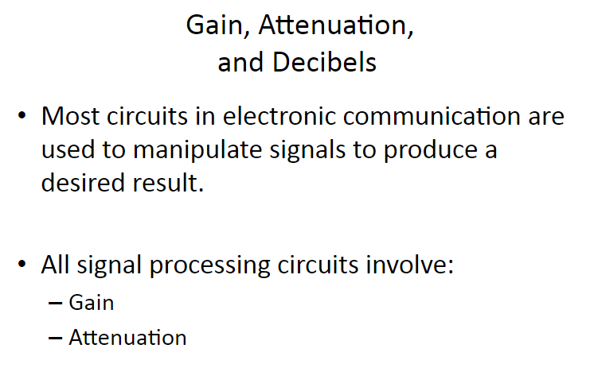

Slide 51
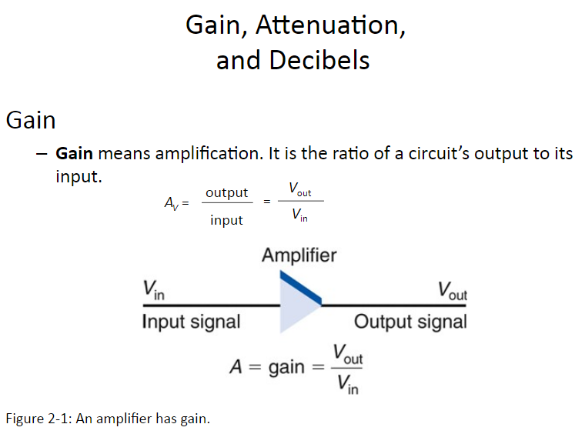

Slide 52
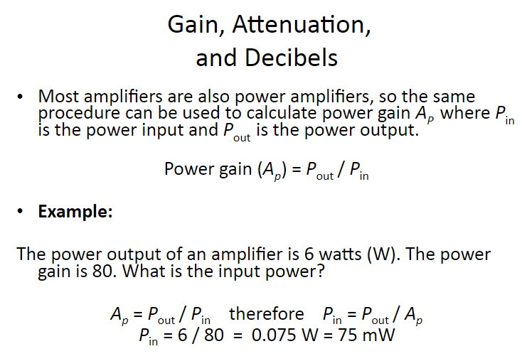

Slide 53
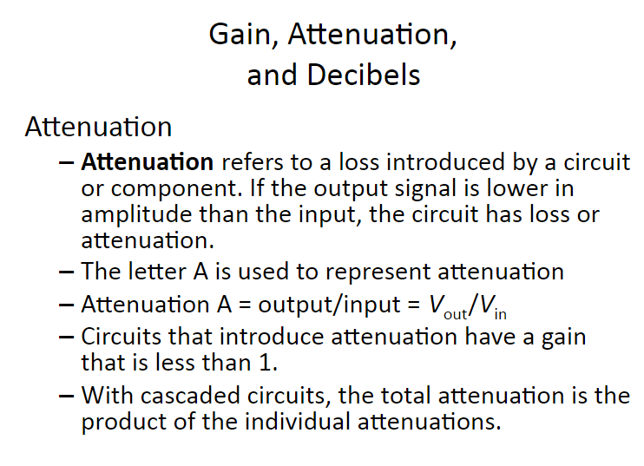

Slide 54
